Slide 1


VISVESVARAYA TECHNOLOGICAL UNIVERSITY RAJARAJESWARI COLLEGE OF ENGINEERING #14,Ramohalli cross, Mysore Road,Kumbalgodu,60074 Affiliated to VTU, Belagavi, Approved by AICTE, New Delhi (Accredited by NAAC ‘A+’ Grade and NBA)
DEPARTMENT OF ELECTRICAL AND ELECTRONICS ENGINEERING
SUBJECT CODE: 21EEP76
TOPIC: “Fault detection in IEEE 9 bus system using Matlab & Simulink ”
Presented By: Under the guidance of
Kiruthika K
Assistant Professor
Dept. of EEE
Bhumika K Ramesh (1RR21EE004) Vishal G (1RR21EE013)
Vivek N (1RR21EE014)
Jyoti (1RR22EE408)

Slide 2
CONTENTS
ABSTRACT
INTRODUCTION
LITERATURE SURVEY
BLOCK DIAGRAM
METHODOLOGY
CIRCUIT DIAGRAM
WORKING PRINCIPLE
COMPONENTS
HARDWARE RESULTS
SOFTWARE RESULTS
ADVANTAGES & DISADVANTAGES
TESTING
REFERENCE
CONCLUSION

Slide 3
ABSTRACT
This project explores fault detection in the IEEE 9 bus system using MATLAB and Simulink. The 9-bus system, known for its complexity, is used to simulate and study various fault types like single line to ground (SLG), line to line (LL), double line to ground (DLG), and three phase faults. The fault detection method employs wavelet transforms to analyze transient responses in voltage and current signals during faults. This approach helps identify fault location and type with high accuracy. The results demonstrate the method’s effectiveness in enhancing the reliability of protection systems, minimizing downtime, and ensuring stable power delivery across the network.

Slide 4
INTRODUCTION
Fault detection is critical for stability and reliability in power systems.
The IEEE 9 bus system is a standard model for studying fault behavior in complex networks.
This project uses MATLAB and Simulink to simulate various fault types (e.g., single line to ground, line to line).
A wavelet transform based algorithm is developed to detect and locate faults accurately.
The approach enhances system resilience, improves fault response time, and ensures consistent power delivery.

Slide 5
LITERATURE SURVEY
SL.NO | TITLE | AUTHOR | YEAR | METHODOLOGY | PARAMETER & INFERENCE | RESOURCE
1. | Hardware Supported Fault Detection and Localization Method for AC Microgrids Using Mathematical Morphology with State Observer Algorithm | Faisal mumtaz | 2023 | Time domain reflectometry is a broadband electrical reflectometry technique that has been successfully used to detect and locate faults on live electrical systems, including power systems. | Hardware Supported Fault Detection | IEEE
2. | Analysis & design of connection between solar farm & IEEE 9 Bus system | Xim Li Kunheng Li | 2021 | The methodology involves selecting Bus5 for connecting a 160 MW solar farm to the IEEE 9-bus system due to its proximity and cost-effectiveness | Usage of IEEE 9 Bus system in the solar farm | IEEE
3. | Simulation of Fault Detection in Photovoltaic System Based On SSTDR | Zhihua Li, Zhanfei Yang, | 2020 | In any electrical power network, the continuity of power flow with high level of reliability is necessary. | Fault Detection in Photovoltaic System Based On SSTDR | IEEE
4. | Protection Scheme based on Fault Detection and Fault Classification using Fuzzy inference system in IEEE-9 Bus System | D. G. Kanade | 2018 | Automated testing technologies, aiming to enhance the efficiency and precision of IC manufacturing processes. | Fuzzy inference System in IEEE-9 BUS System | IEEE
5. | PSCAD/EMTDC-based Simulations for Fault Analysis and Fault Identification in 380V Ring DC Systems. | Julia Niewind, Nasser G.A. Hemdan | 2017 | With an increasing number of DC driven components in power networks, the introduction of 380V DC distribution grids appears to be a valuable option. Besides all positive aspects of DC systems | PSCAD/EMTDC-based Simulations | IEEE

Slide 6
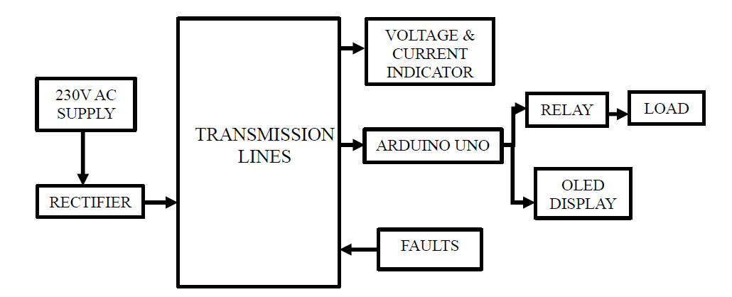
BLOCK DIAGRAM

Slide 7
METHODOLOGY
Power Supply & Conversion: 230V AC Converted To DC Via A Rectifier.
Transmission Lines: Core Component Where Faults May Occur.
Monitoring Components: Voltage & Current Indicators Track Electrical Parameters.
Arduino Uno: Central Control Unit For Processing And Response.
Relay Control: Arduino Manages Relay To Protect The Load.
OLED Display: Shows System Status And Fault Conditions.
Fault Detection Module: Continuously Monitors Transmission Lines For Abnormalities.
Protective Actions: System Triggers Relay Upon Fault Detection To Safeguard The Load.
Software Integration: Matlab & Simulink Used For Simulation And Control.
Purpose: Enables Real-time Monitoring, Fault Detection, And Protection In Power Distribution.
7

Slide 8
CIRCUIT DIAGRAM

Slide 9
WORKING PRINCIPLE
The system consists of two Arduino Uno boards working together to control and monitor eight AC light lines through relay modules. Each Arduino manages four relay modules, with Arduino Uno 1 controlling relays 1-4 and Arduino Uno 2 controlling relays 5-8.
The setup is powered by a 9V DC supply derived from AC power through a rectifier circuit. Each Arduino board is equipped with an OLED display connected via I2C protocol (using pins A4 and A5) to show real-time voltage and current measurements of the monitored lines.
The core functionality revolves around power monitoring and protection. The system continuously monitors voltage (through pins A0-A3) and current (through pins A4-A7) for each line, comparing them against preset thresholds (10V for voltage and 2A for current).
If voltage drops too low or current exceeds the safe limit, the corresponding relayswitches off automatically, and the system activates the next relay in sequence.
Each relay module connects to an AC light holder using a Normally Open (NO) configuration for the live wire and Common (COM) for the neutral wire, ensuring safe switching and electrical isolation between the control circuit and AC power lines.

Slide 10
COMPONENTS
ARDUINO UNO
Data Acquisition: Arduino receives voltage and current readings from sensors connected to the transmission lines.
Fault Detection: Based on predefined thresholds, Arduino processes the sensor data to detect faults such as overvoltage, overcurrent, or short circuits.
Control Relay: Upon detecting a fault, Arduino triggers the relay to disconnect the load, ensuring the safety of the system.
Display Information: Arduino sends fault details and real-time voltage and current values to an OLED display for user monitoring.
Fault Classification: By analyzing the sensor input, Arduino classifies the type of fault and can display this information for further analysis.

Slide 11
COMPONENTS
Parameter Monitoring: It measures the current and voltage levels in the transmission line to ensure they are within the safe operating range.
Real-Time Display: The indicator provides a visual representation of current and voltage, allowing operators to continuously monitor the system's performance.
Fault Identification Support: By showing abnormal voltage or current values during faults, the indicator helps identify issues like overcurrent, overvoltage, or system imbalance.
System Troubleshooting: It assists in diagnosing issues within the system by providing instantaneous electrical readings, which can pinpoint the location or nature of a fault.
Safety Assurance: By offering immediate feedback on system conditions, the indicator helps prevent potential hazards caused by undetected electrical anomalies.

Slide 12
COMPONENTS
Load Control: The relay module allows the Arduino Uno to control the connection and disconnection of the load from the power supply, providing automation in the system's operation.
Fault Isolation: When a fault is detected, the Arduino signals the relay module to isolate the faulty section of the circuit, protecting the load and other components from damage.
Multiple Circuit Management: With four independent relays, the module can control multiple circuits or devices, making it versatile for applications involving different loads or sections of a transmission system.
Electrical Safety: The relay module acts as an intermediary, ensuring that the low-voltage signals from the Arduino can control high-voltage circuits without direct electrical connection, enhancing operator and system safety.
Automatic Reset or Reconnection: After fault clearance, the relay can be reset automatically or manually to restore the connection, maintaining system reliability.

Slide 13
COMPONENTS
Real-Time Monitoring: Displays live voltage and current readings for each AC light line.
Fault Indication: Shows alerts when voltage drops below 10V or current exceeds 2A.
Relay Status Display: Indicates which relay is active or switched off.
User Interface: Provides clear, easy-to-read system status updates.
I2C Communication: Uses A4 (SDA) and A5 (SCL) pins for efficient data transmission.
Compact & Low Power: Consumes minimal power, making it ideal for continuous monitoring.

Slide 14
COMPONENTS
AC to DC Conversion: Converts AC power to DC for Arduino and relay module operation.
Stable Power Supply: Provides a consistent 9V DC output from an AC source.
Protection: Ensures smooth operation by eliminating AC voltage fluctuations.
Isolation: Prevents direct AC exposure to low-voltage components, enhancing safety.
Continuous Operation: Enables uninterrupted power monitoring and control.

Slide 15
COMPONENTS
Real-Time Display: Shows voltage, current, or relay status numerically.
Fault Indication: Displays error codes or alerts for abnormal conditions.
User-Friendly Interface: Provides a clear and quick visual reference.
Relay Monitoring: Indicates which relay is active or switched off.
Compact & Efficient: Uses minimal power while offering high visibility.

Slide 16
COMPONENTS
Secure Connection: Provides a stable and safe interface for AC light bulbs.
Relay Control Implementation: Allows switching ON/OFF bulbs via relay modules.
Electrical Isolation: Ensures safe handling of live and neutral wires.
Load Representation: Acts as the actual load to test power monitoring and protection.
System Functionality Testing: Helps verify the effectiveness of relay switching and fault detection.

Slide 17
HARDWARE RESULTS

Slide 18
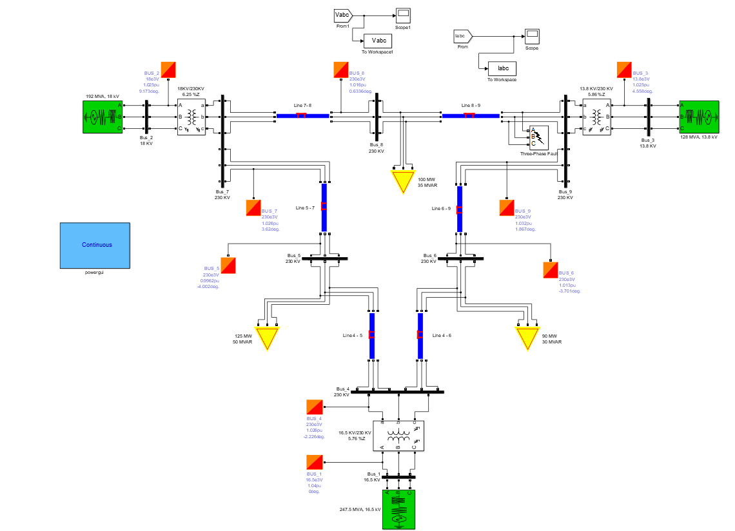
SOFTWARE RESULTS

Slide 19
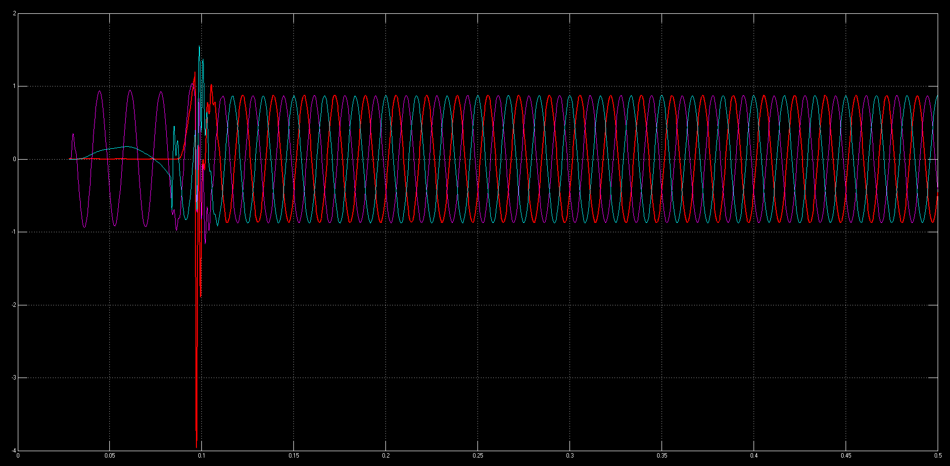
SOFTWARE RESULTS
Voltage Characteristics of the Line – Ground Fault

Slide 20
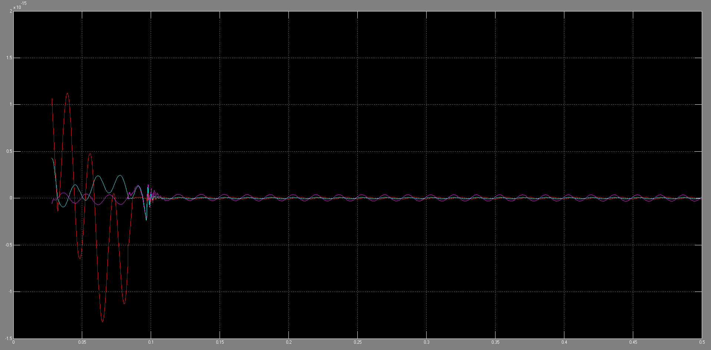
SOFTWARE RESULTS
Current Characteristics of the Line – Ground Fault

Slide 21
TESTING

Slide 22
ADVANTAGES & DISADVANTAGES
Benchmark For Research
Manageable Complexity
Representation Of Real-world Systems
Suitable For Diverse Studies
Adaptability
Limited Scalability
Inadequate For Modern Studies
Limited Fault Analysis
Reduced Scope Of Optimization Studies

Slide 23
CONCLUSION
The IEEE 9-bus system is a foundational model in power systems research and education, offering a balance between simplicity and functional complexity. It enables detailed studies in load flow, fault analysis, stability, and optimization, serving as a benchmark for testing algorithms and control strategies. Despite its advantages, its small scale and idealized assumptions limit its applicability for modern, large-scale, and renewable-integrated systems. However, its adaptability and widespread documentation make it an invaluable tool for foundational learning and early-stage research.
23

Slide 24
REFERENCE
[1] Prof. Faisal Mumtaz, Hardware Supported Fault Detection and Localization Method for AC Microgrids Using Mathematical Morphology with State Observer Algorithm, 21 November 2023,IEEE
[2] Prof. Xin Li, Analysis and design of connection between solar farm and IEEE 9 bus system, 2021,IEEE
[3] Zhihua Li, Zhanfei Yang, Chunhua Wu, Simulation of Fault Detection in Photovoltaic System Based On SSTDR,2020,IEEE
[4] Aditya Patel, M.V.S. Prashant, Jharna Sahu, Ancy Prerena Kujur Department of Electrical and Electronics Engineering Bhilai Institute of Technology Raipur ,Protection Scheme based on Fault Detection and Fault Classification using Fuzzy inference system in IEEE-9 Bus System, 2018,IEEE
[5] Frank Gerdinand, Johann Meisner and Stephan Passon, PSCAD/EMTDC-based Simulations for Fault Analysis and Fault Identification in 380V Ring DC Systems,2017,IEEE
24

Slide 25
THANK YOU

